Slide 1

SQL Data Types:A Comprehensive Overview
Majd saoud abbas
@MentorNEss

Slide 2
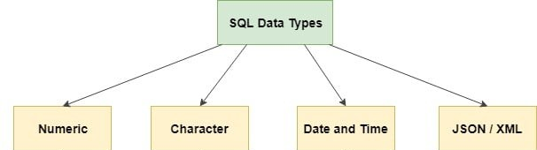
Intro:
SQL (structured query language) supports various data types for storing and manipulating data.
Understanding these data types is crucial for efficient database design and query execution.
The data type of a column defines what value the column can hold: integer, character, money, date and time, binary, and so on.
There are three main data types: numeric, string, date and time,and other.

Slide 3
Numeric Data Types
Exact Numeric Datatype:
Data Type | From | To
BigInt | -2⁶³ (-9,223,372,036,854,775,808) | 2⁶³ -1 (9,223,372,036,854,775,807)
Int | -2³¹ (-2,147,483,648) | 2³¹-1 (2,147,483,647)
smallint | -2¹⁵ (-32,768) | 2¹⁵-1 (32,767)
tinyint | 0 | 2⁸-1 (255)
bit | 0 | 1
decimal | -10³⁸+1 | 10³⁸-1
numeric | -10³⁸+1 | 10³⁸-1
money | -922,337,203,685,477.5808 | 922,337,203,685,477.5807
smallmoney | -214,748.3648 | 214,748.3647
Notes:
These are used to store numeric values.

Slide 4
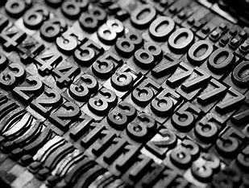
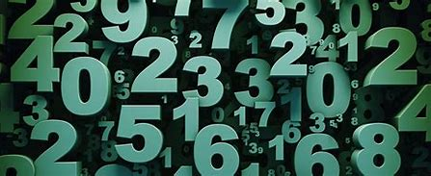
Numeric Data Types
Approximate Numeric Datatype:
Data Type | From | To
Float | -1.79E+308 | 1.79E+308
Real | -3.40E+38 | 3.40E+38

Slide 5
String Data Types
Character String Data Types:
Data Type | Description
char | The maximum length of 8000 characters.(Fixed-Length non-Unicode Characters)
varchar | The maximum length of 8000 characters.(Variable-Length non-Unicode Characters)
varchar(max) | The maximum length of 231 characters(SQL Server 2005 only).(Variable Length non-Unicode data)
text | The maximum length of 2,127,483,647 characters(Variable Length non-Unicode data)
Notes:
These are used to store character strings.

Slide 6


String Data Types
Unicode String Data Types:
Data Type | Description
nchar | The maximum length of 4000 characters(Fixed-Length Unicode Characters)
Nvarchar | The maximum length of 4000 characters.(Variable-Length Unicode Characters)
nvarchar(max) | The maximum length of 231 characters(SQL Server 2005 only).(Variable Length Unicode data)

Slide 7
String Data Types
Server String Data Types:
Datatypes | Description
Binary | The maximum length of 8000 bytes(Fixed-Length binary data)
varbinary | The maximum length of 8000 bytes(Variable Length binary data)
varbinary(max) | The maximum length of 231 bytes(SQL Server 2005 only).(Variable Length binary data)
text | Maximum Length of 2,147,483,647 bytes(Variable Length binary data)
Notes:
These are used to store binary data, such as images or audio files

Slide 8
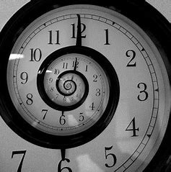
Server Date and Time Data Types
Data Type | Description
DATE | A data type is used to store the data of date in a record
TIME | A data type is used to store the data of time in a record
DATETIME | A data type is used to store both the data,date, and time in the record.

Slide 9
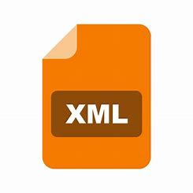
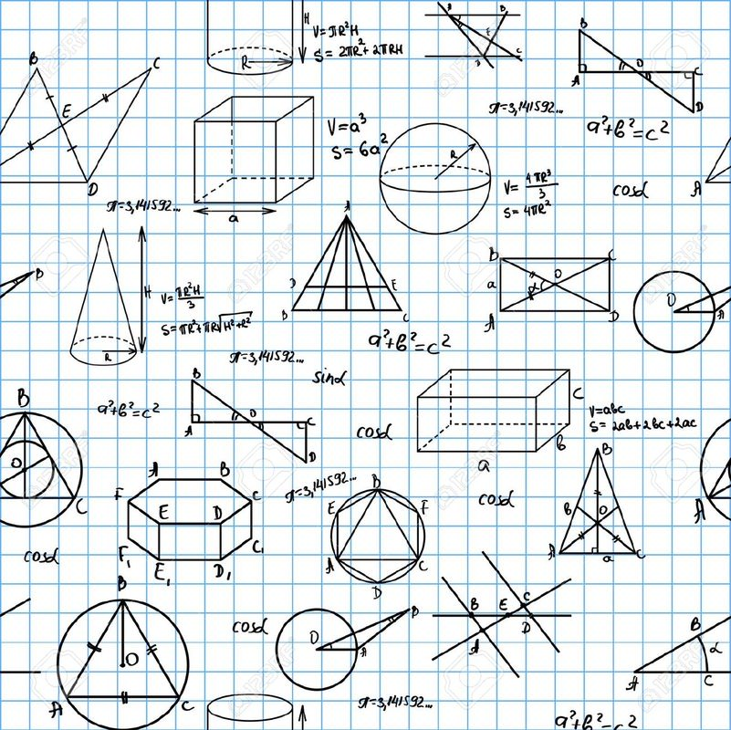

Other Data Types
DataType | Description
XML Datatype | A datatype used to store data in the format of XML datatype
Geometry | A datatype is used for storing planar spatial data, such as points, lines, and polygons, in a database table.
Array data types | These are used to store arrays of values. Examples include ARRAY and JSON.

